Slide 1
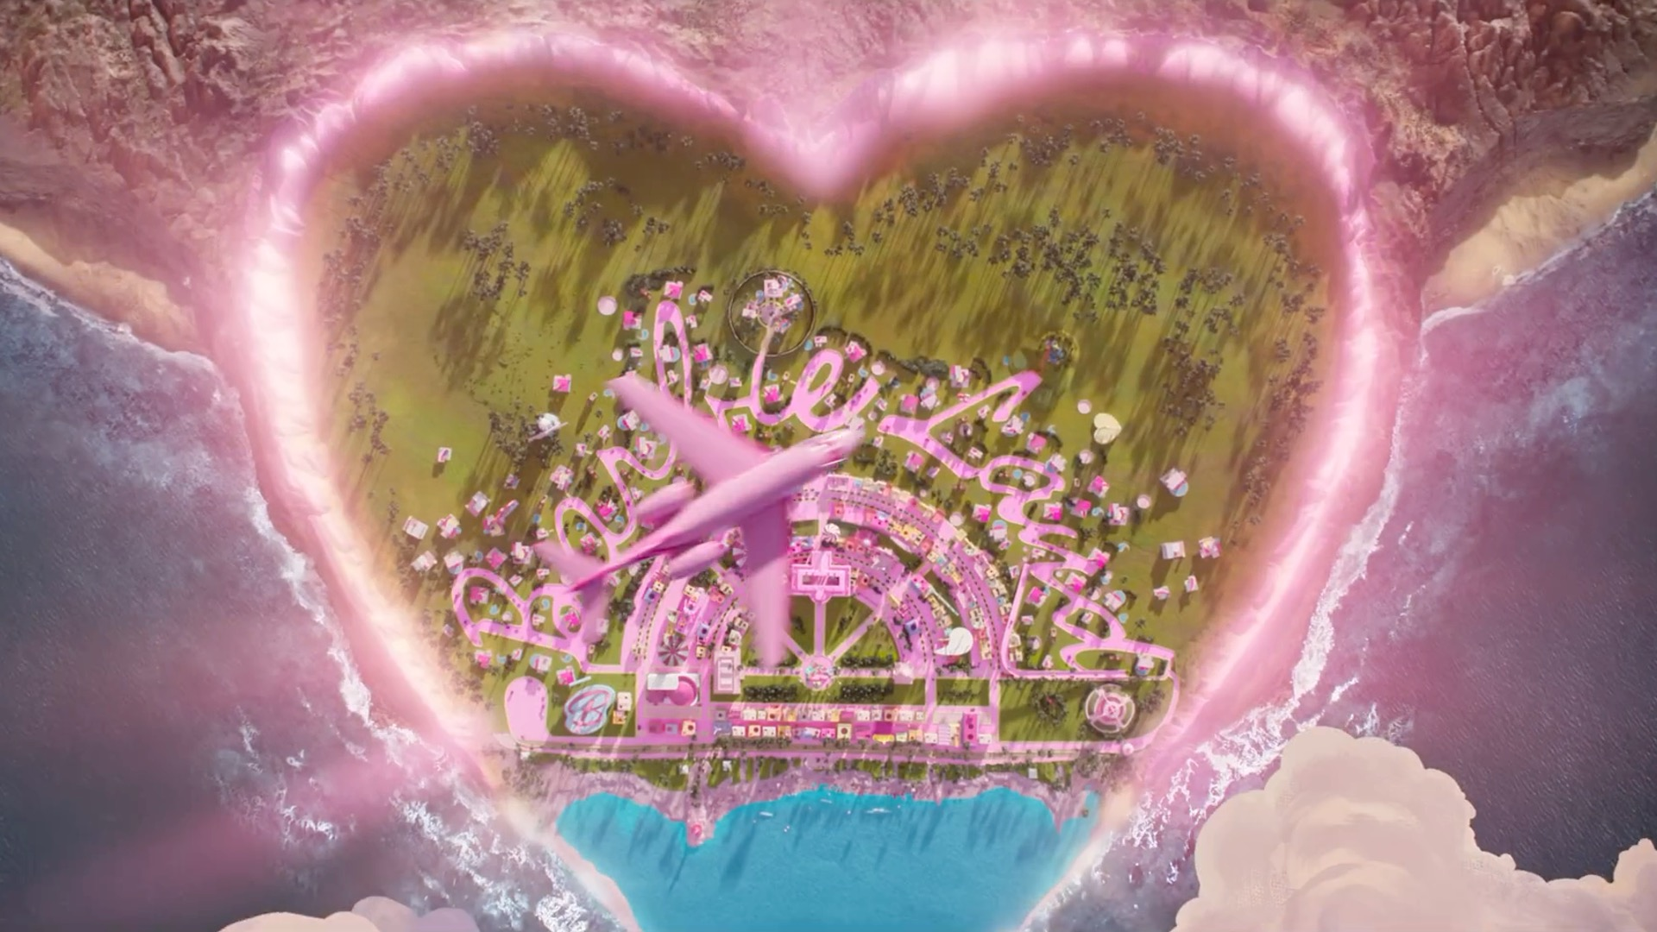

Slide 2
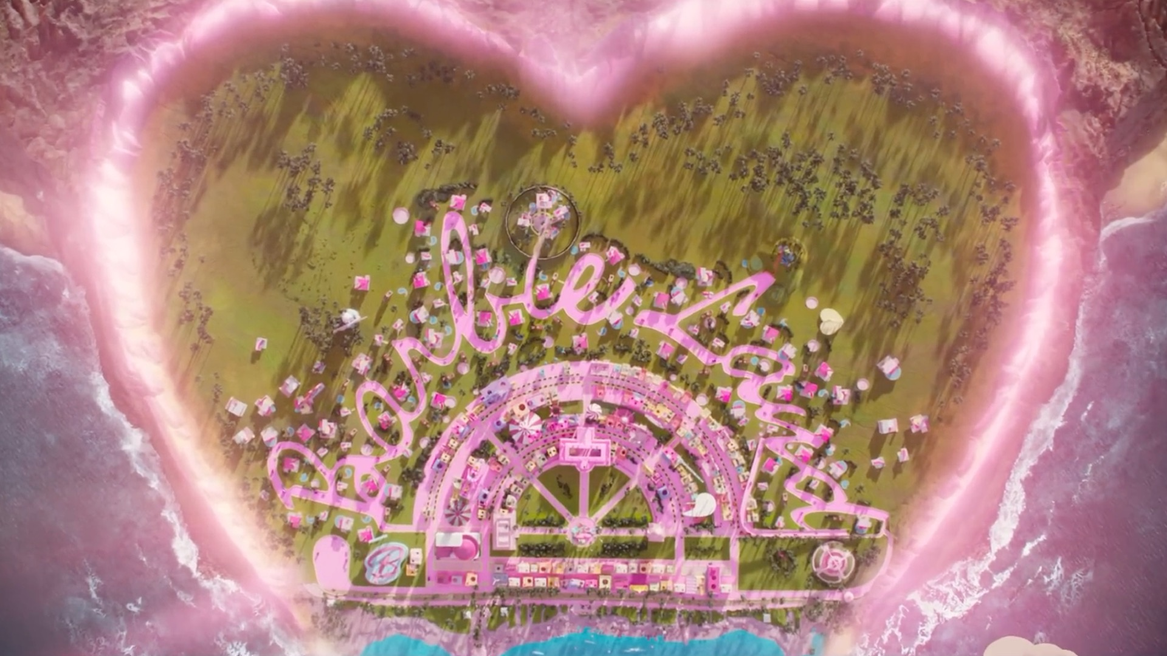
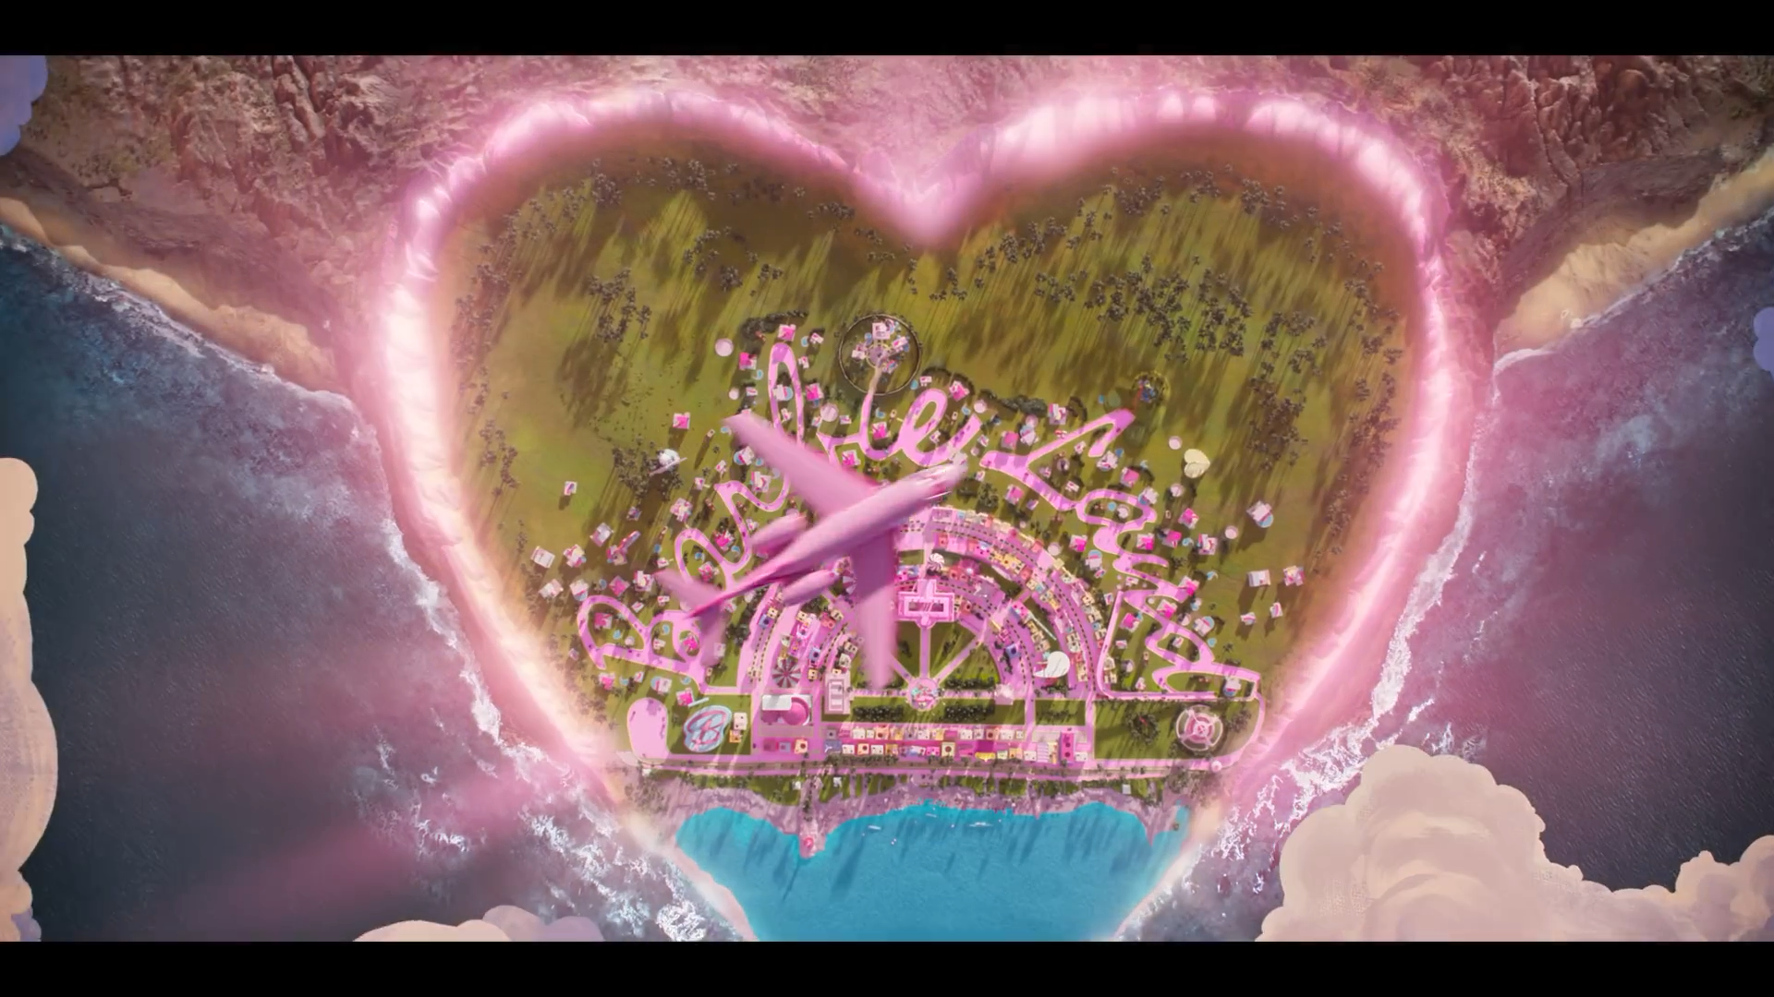

watch
Barbie
Admit
One
with me
To:
From:
My Ken-tastic
The Barbie
boyfriend
of your dreams

Slide 3
watch
Barbie
Admit
One
with me
To:
From:
My Ken-tastic
The Barbie
boyfriend
of your dreams

Slide 4
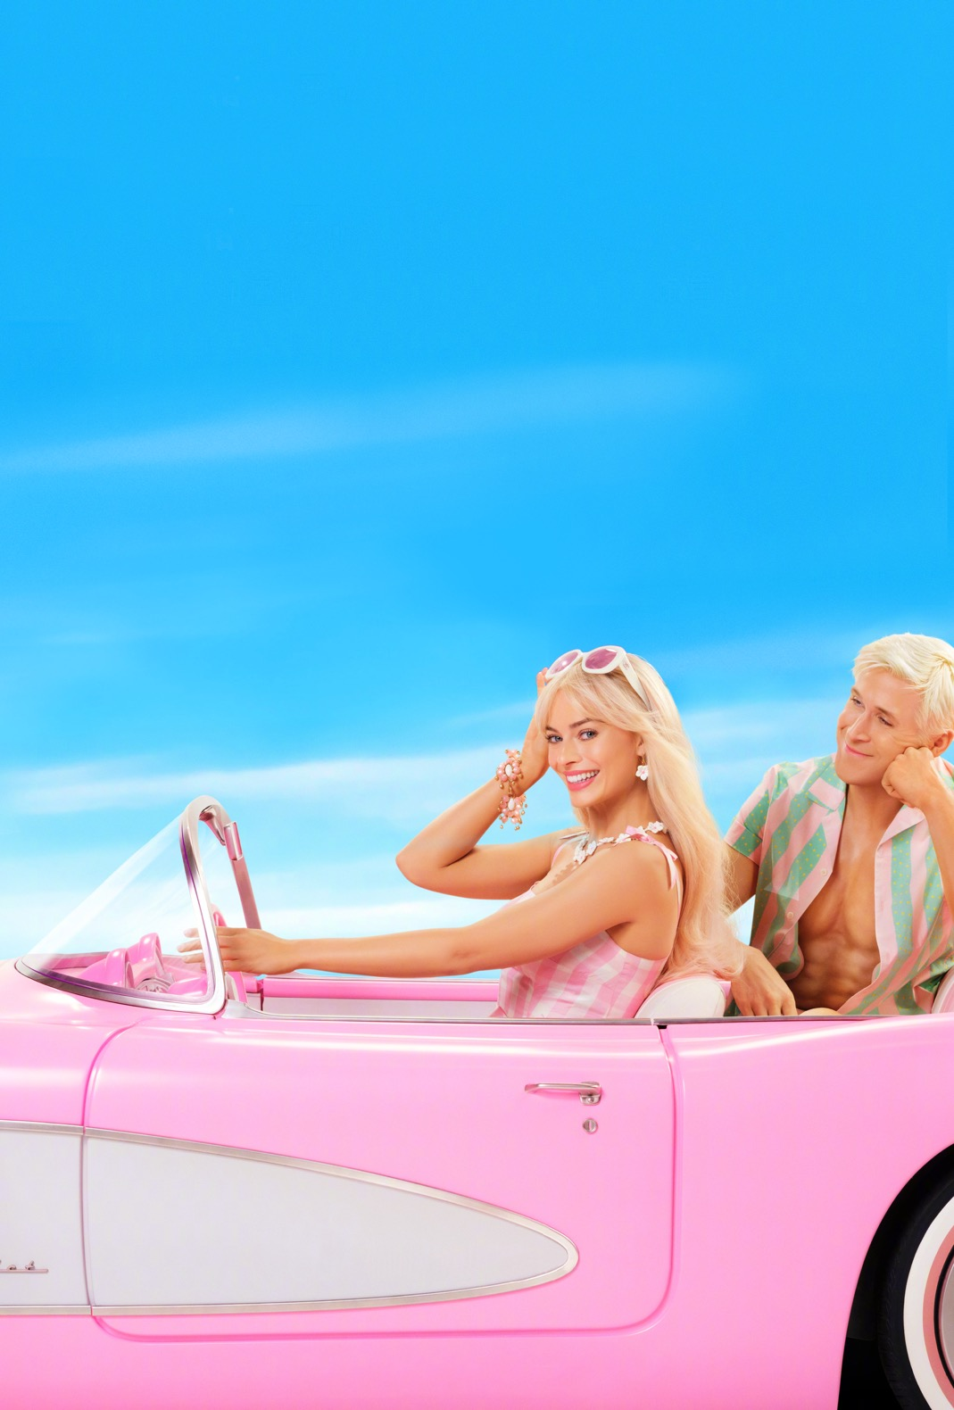
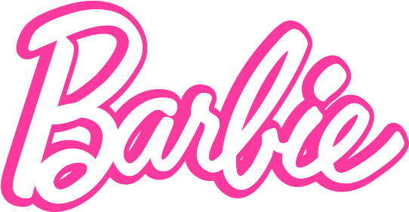
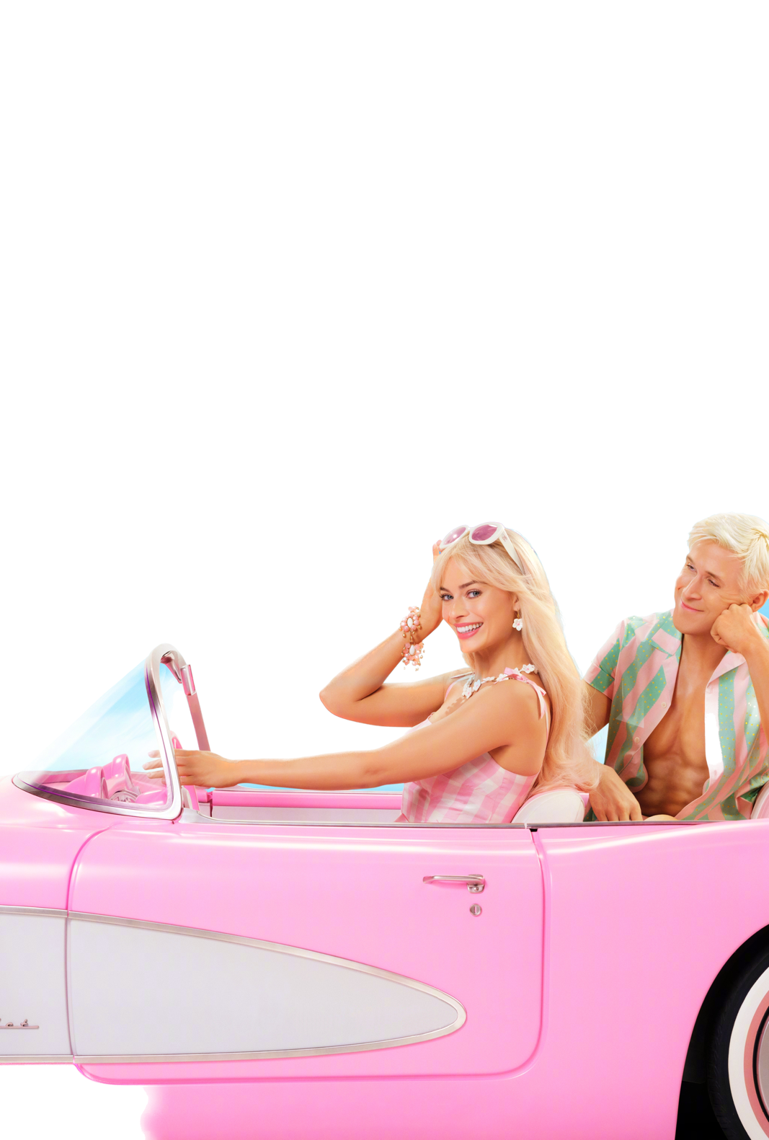

watch
Barbie
Admit
One
with me
To:
From:
My Ken-tastic
The Barbie
boyfriend
of your dreams
THE ICONIC LEGACY OF
Doll-icious Adventures!
Step into a World of Glitter, Glam, and Barbie-tastic Style!
Barbiecore
The Fashion Trend Taking the World by Storm
Life in the Dreamhouse
Peek into a World of Whimsy!
HOW BARBIE CONQUERED THE WORLD!
Dream Big with Barbie
Inspiring Stories of Success!

Slide 5
watch
Barbie
with me
To:
From:
My Ken-tastic
The Barbie
boyfriend
of your dreams
THE ICONIC LEGACY OF
Doll-icious Adventures!
Step into a World of Glitter, Glam, and Barbie-tastic Style!
Barbiecore
The Fashion Trend Taking the World by Storm
Life in the Dreamhouse
Peek into a World of Whimsy!
HOW BARBIE CONQUERED THE WORLD!
Dream Big with Barbie
Inspiring Stories of Success!
Admit
One

Slide 6
THE ICONIC LEGACY OF
Doll-icious Adventures!
Step into a World of Glitter, Glam, and Barbie-tastic Style!
Barbiecore
The Fashion Trend Taking the World by Storm
Life in the Dreamhouse
Peek into a World of Whimsy!
HOW BARBIE CONQUERED THE WORLD!
Dream Big with Barbie
Inspiring Stories of Success!

Slide 7
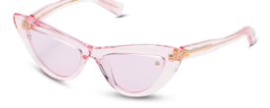
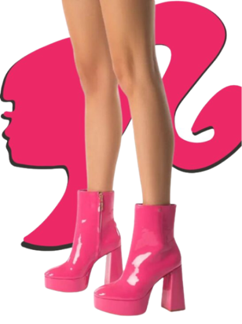
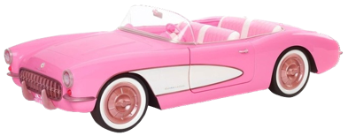
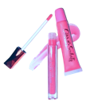
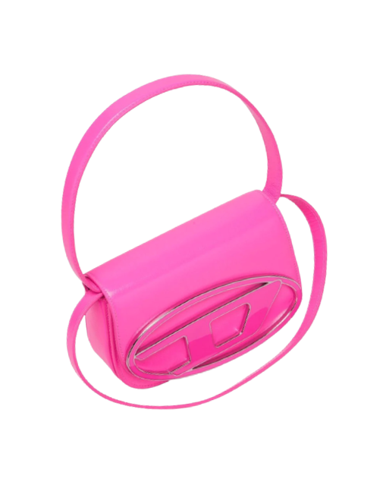
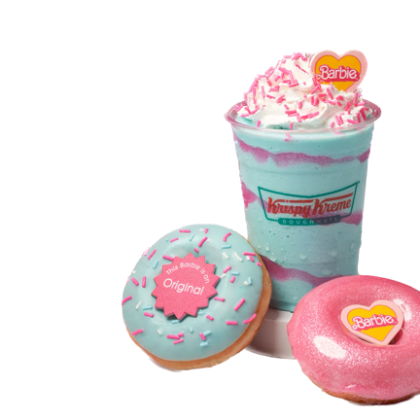
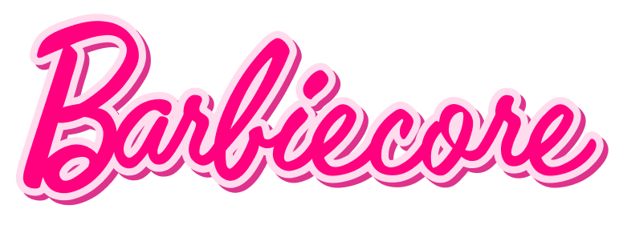
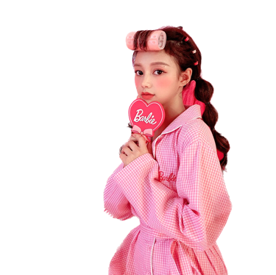
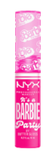
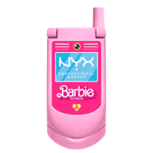
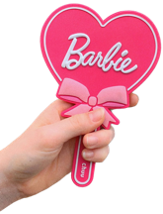
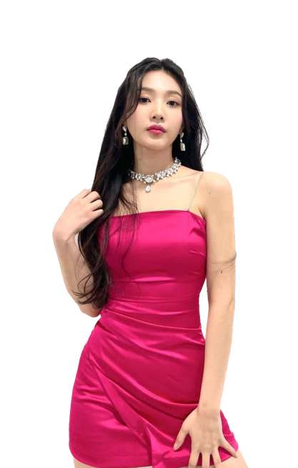
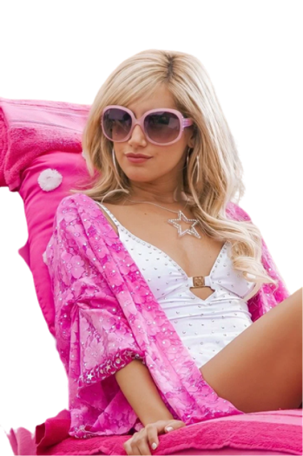
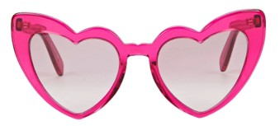
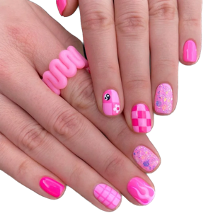
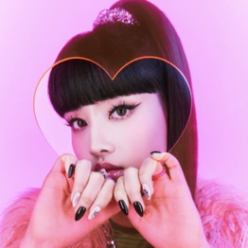
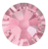
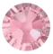
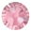
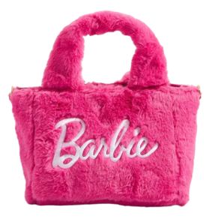
The history of
A Trend That Transcends Generations
Barbiecore isn't just for the younger generation. Discover how women of all ages are embracing this trend and incorporating Barbie-inspired elements into their everyday style. From mothers passing down their love for Barbie to younger generations rediscovering the magic, Barbiecore is a trend that transcends time.
Rise of Barbiecore in Asia
What is Barbiecore?
Over in the West, the heyday of Barbie, and concurrently, the origin of Barbiecore, was around the 90s to 2000s. At heart, Barbiecore is about having a fun time and not taking yourself too seriously.
The playful charm and chic associated with Barbie in the 2000s is revived in the movie’s aesthetic and Margot Robbie’s embodiment of the character. The marketing again reflects this light-hearted classiness of Barbie. Once more, we are mesmerized by Barbie’s lively and bubbly energy, by her endearing essence and personality.
Fast forward to the 2020s and suddenly we see elements and themes of Barbiecore slipping into East Asian pop culture. The appearance of bright pink in the Gamer Girl aesthetic, Kpop concepts, and the doll-like philosophy of Douyin makeup.
Barbiecore is a term that has emerged in recent years to describe a fashion and aesthetic trend that draws inspiration from the iconic doll, Barbie.
Embrace the Power of Pink
Barbiecore fashion is a vibrant and inclusive trend that transcends boundaries and welcomes individuals from all walks of life. It embraces diversity and celebrates the uniqueness of every individual, regardless of their shape, size, or background. This fashion movement is a powerful statement about self-expression, empowering people to confidently embrace the Barbiecore look and make it their own.
A Stunning Fall from Grace
But this 2000s golden, or pink, era of Barbiecore, only lasted for a decade or so.
Concerns about the hyperfeminine aesthetic began to surface. The result of this outcry was Barbie being a lot less, well, “Barbiecore.” Glamorous “Get Your Sparkle On” dress? More like wannabe Hannah Montana outfit.
Mattel wanted to rebrand Barbie as your average girl next door, but no one wanted to watch average. Like the Halo Effect suggests, what is beautiful is good and the new Barbie was lacking all the Shimmer, Shyne and Glimmer.
Unleash Your Inner Doll
Accessorizing is key in the Barbiecore world. Sparkling jewelry, like dainty necklaces and shimmering bracelets, will add that extra touch of glamour. Don't forget about hair accessories like oversized bows or glittery hair clips that will make you feel like a true Barbie doll.
I have even seen some Barbie-inspired photoshoots by Asian influencers popping up on feed and Chinese brands selling Barbiecore clothes. It seems like this curiosity around Barbiecore is only going to keep shooting up.
It is a style that combines elements of nostalgia, femininity, and playfulness to create a unique and visually striking look. Barbiecore is characterized by bright and pastel colors, sparkles, bows, and exaggerated feminine details.
So we see that Barbiecore is not so much of a revival in the East, but a novel trend. But what caused this? What does Barbiecore mean to the East when much of the lore and Western
“Ms. genius Greta Gerwig bought back all that was iconic about Barbie.”

Slide 8
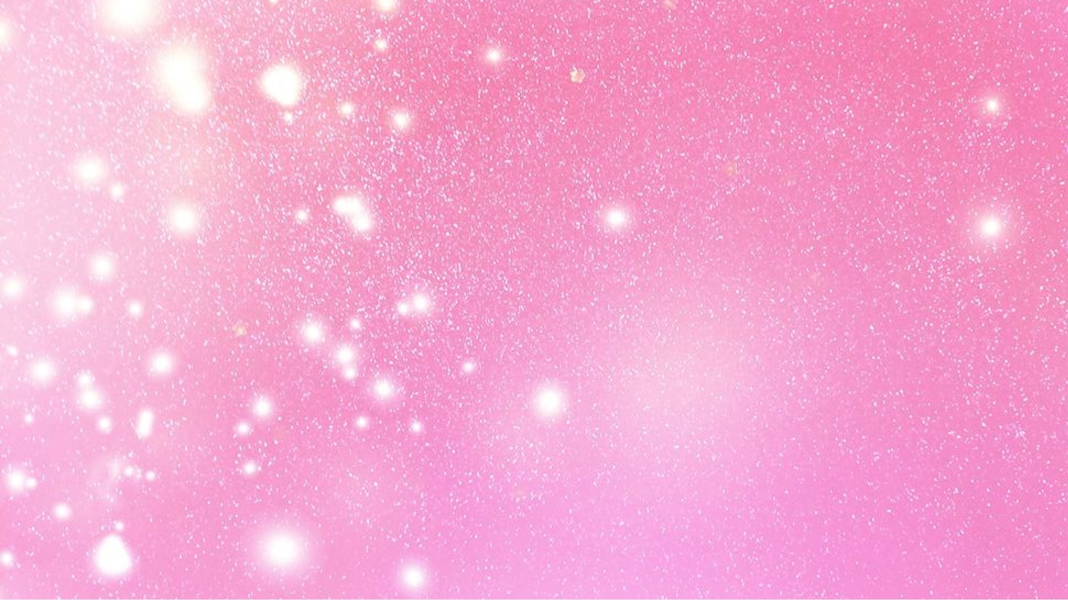
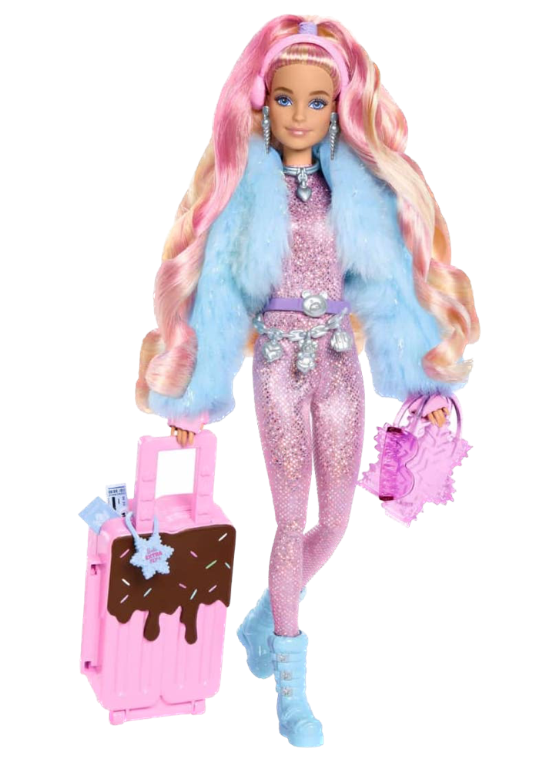

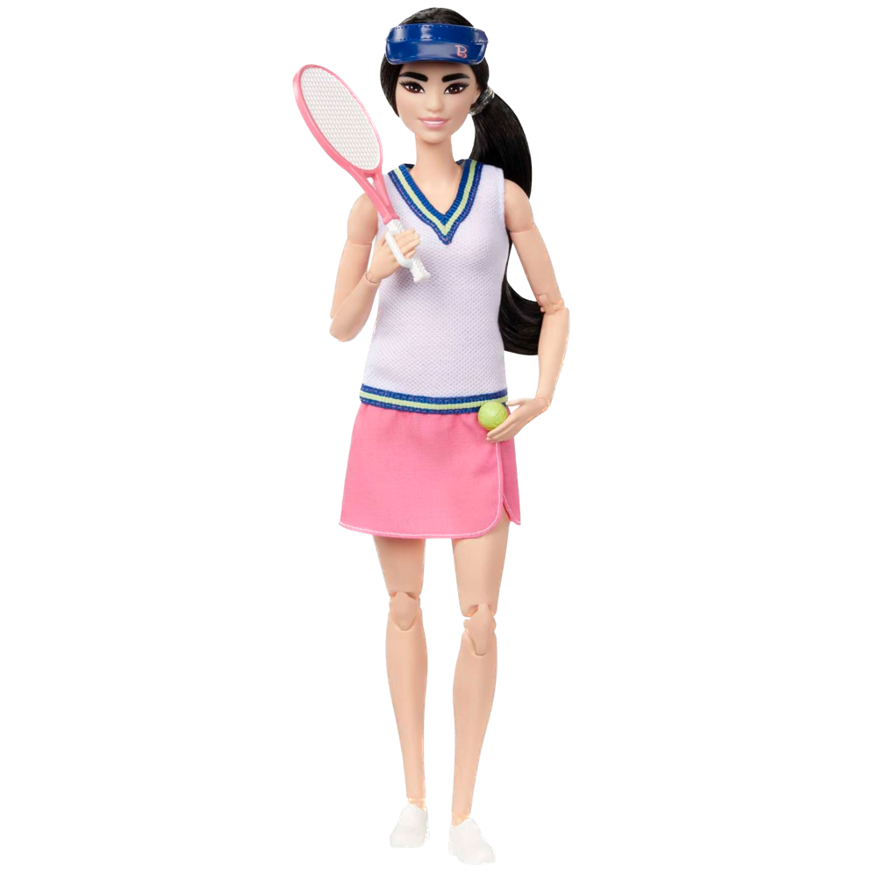
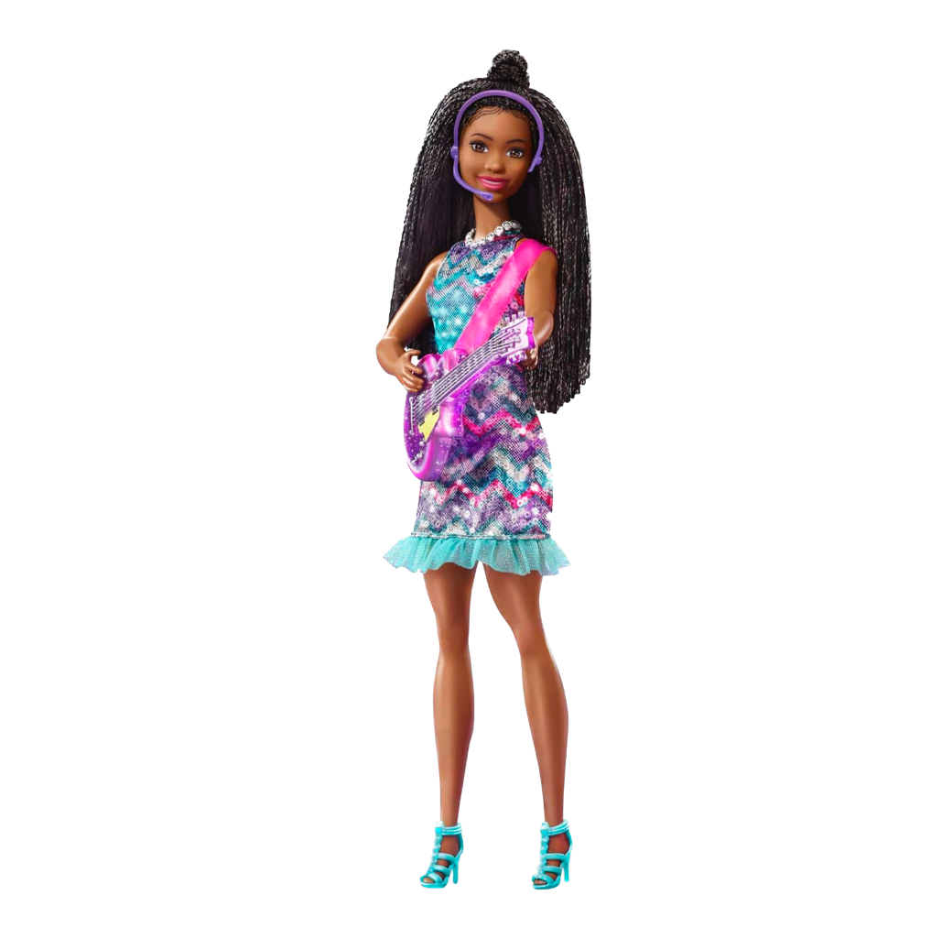
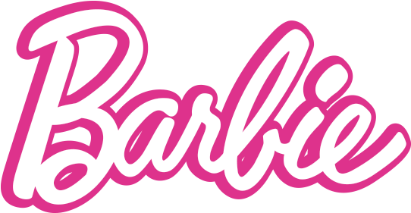


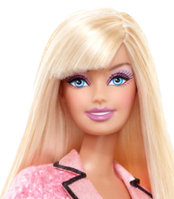
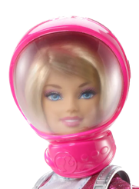
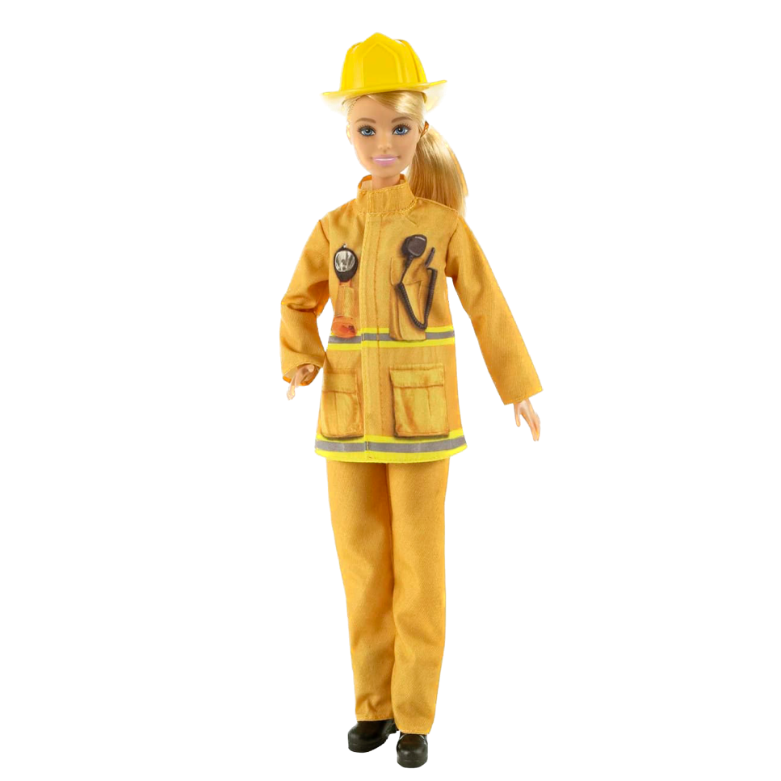
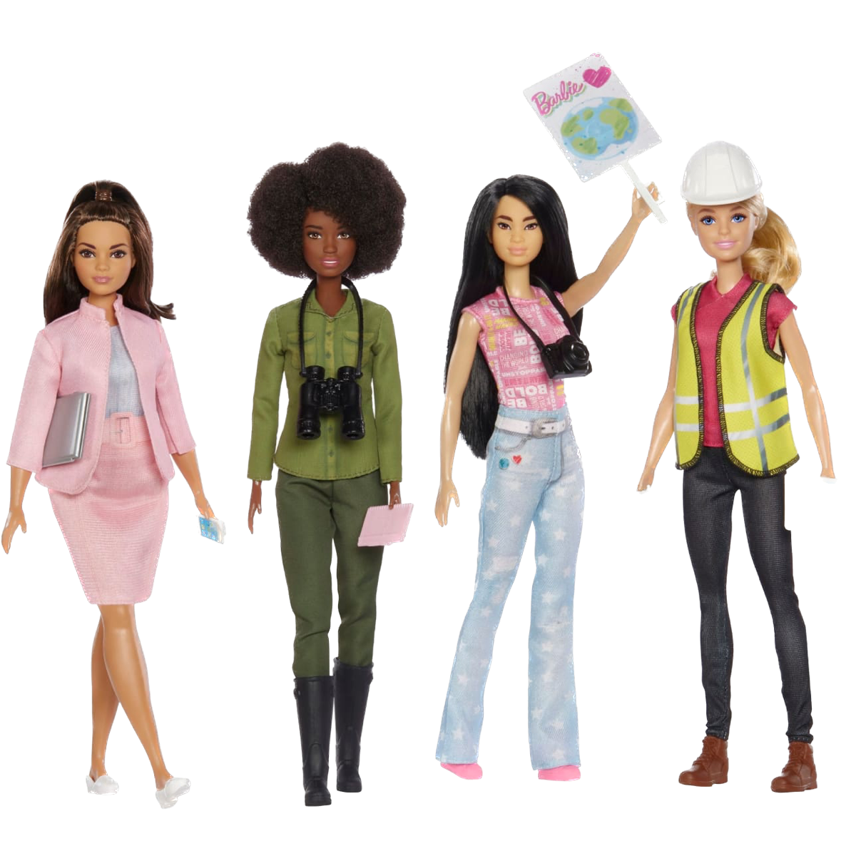
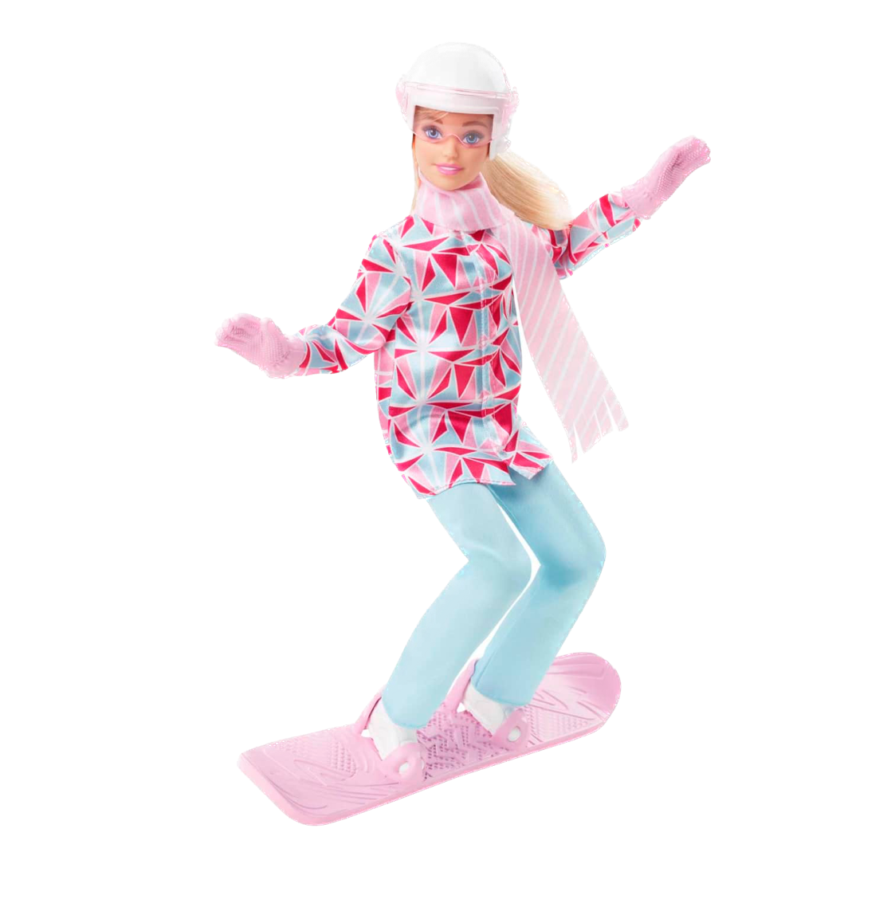
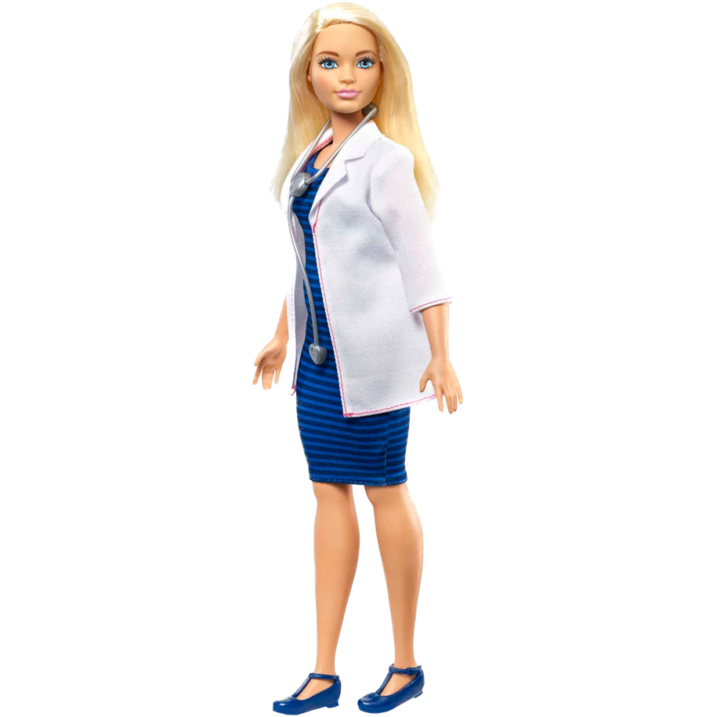
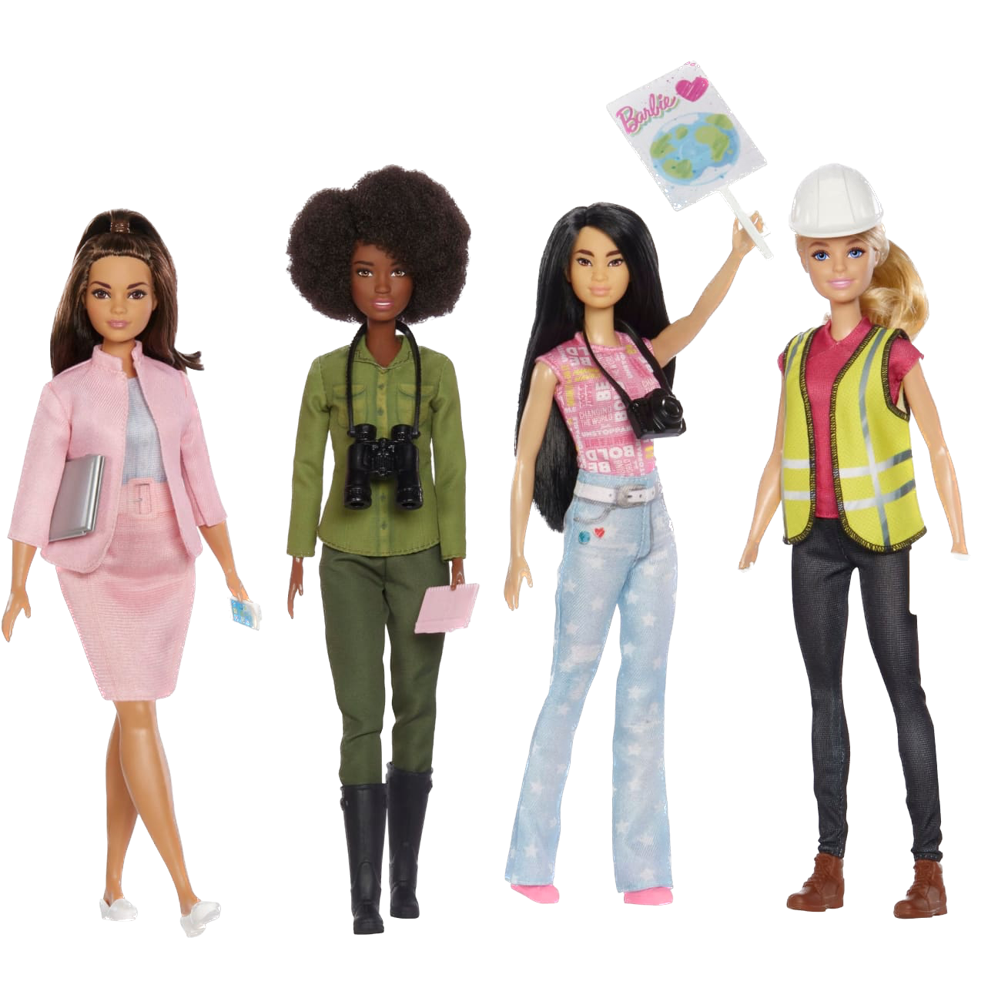

Choose Your Player
Select
Set
View
Back
Fashionista

Slide 9

Choose Your Player
Select
Set
View
Back
Tennis Player

Slide 10

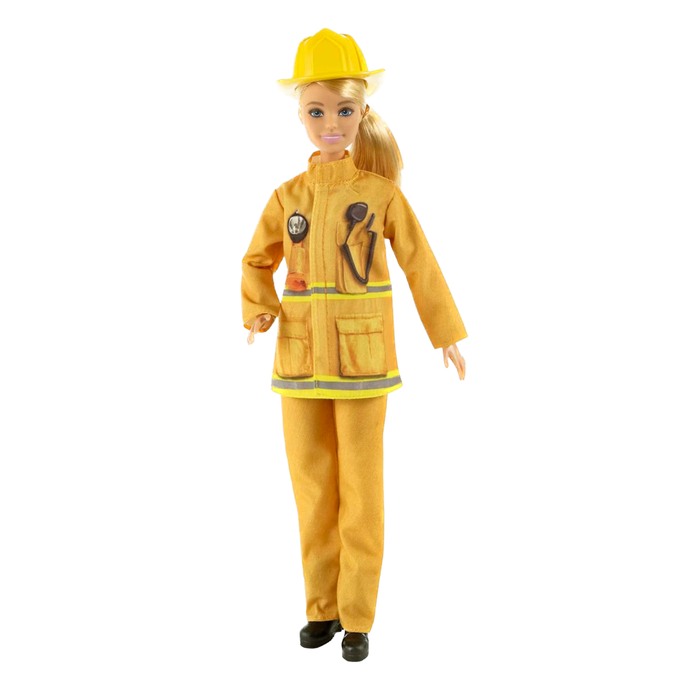
Choose Your Player
Select
Set
View
Back
Pop Star

Slide 11

Choose Your Player
Select
Set
View
Back
Firefighter

Slide 12

Choose Your Player
Select
Set
View
Back
Astronaut

Slide 13


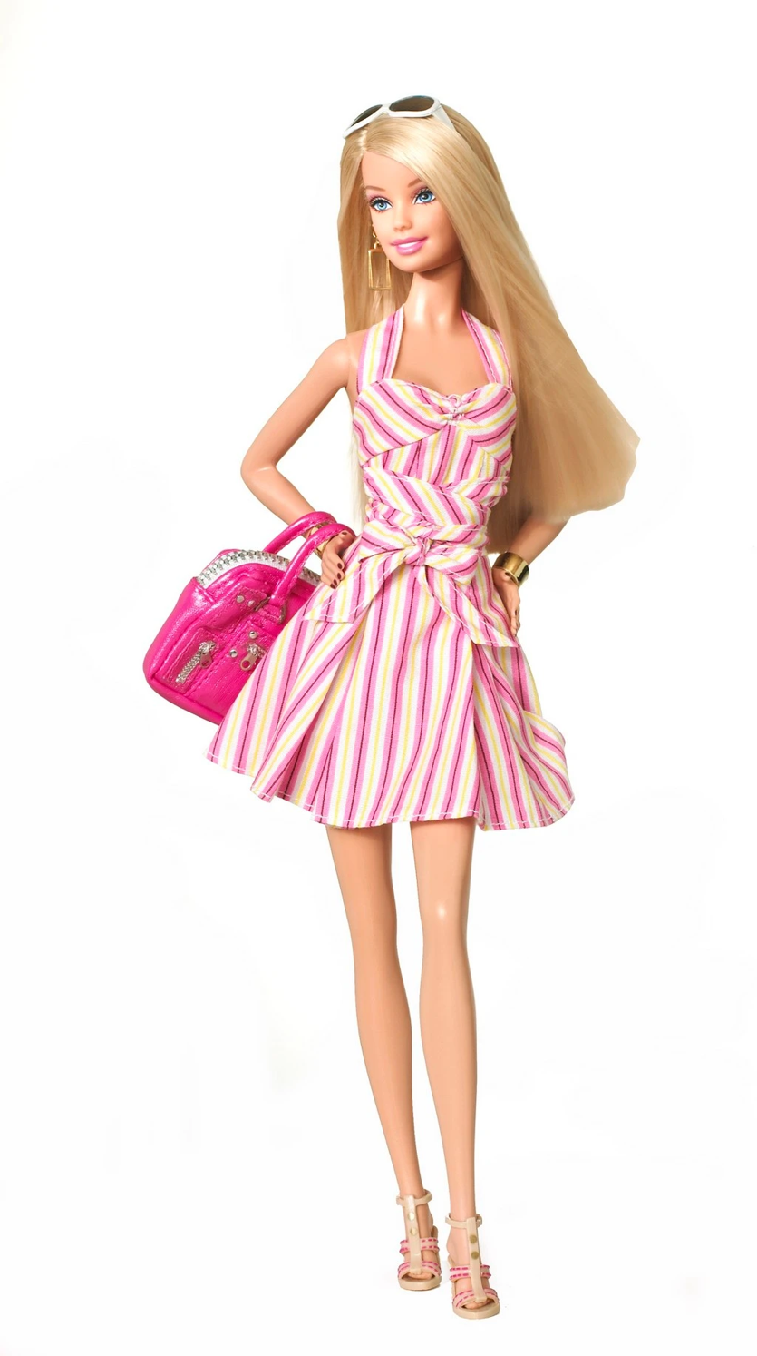
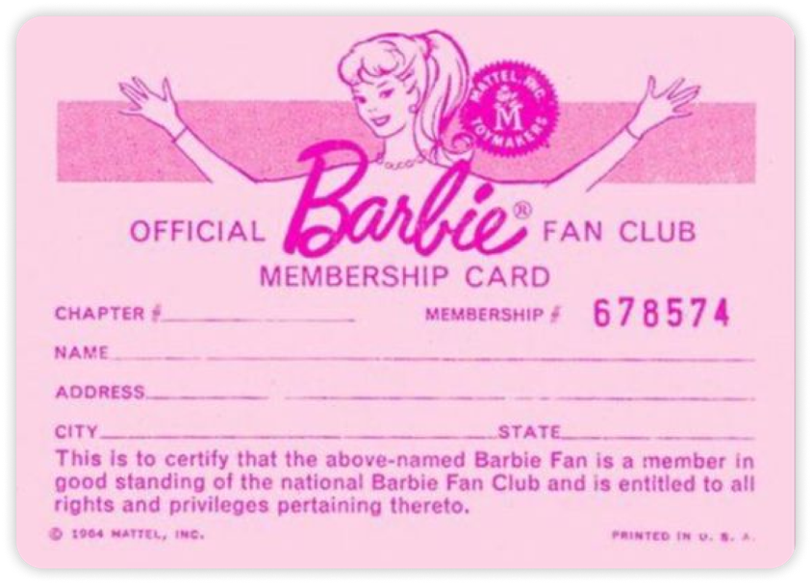







Slide 14

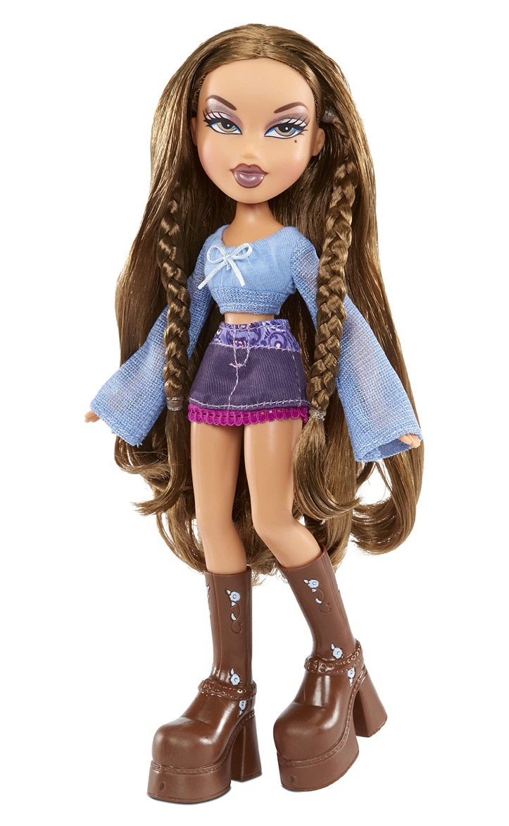
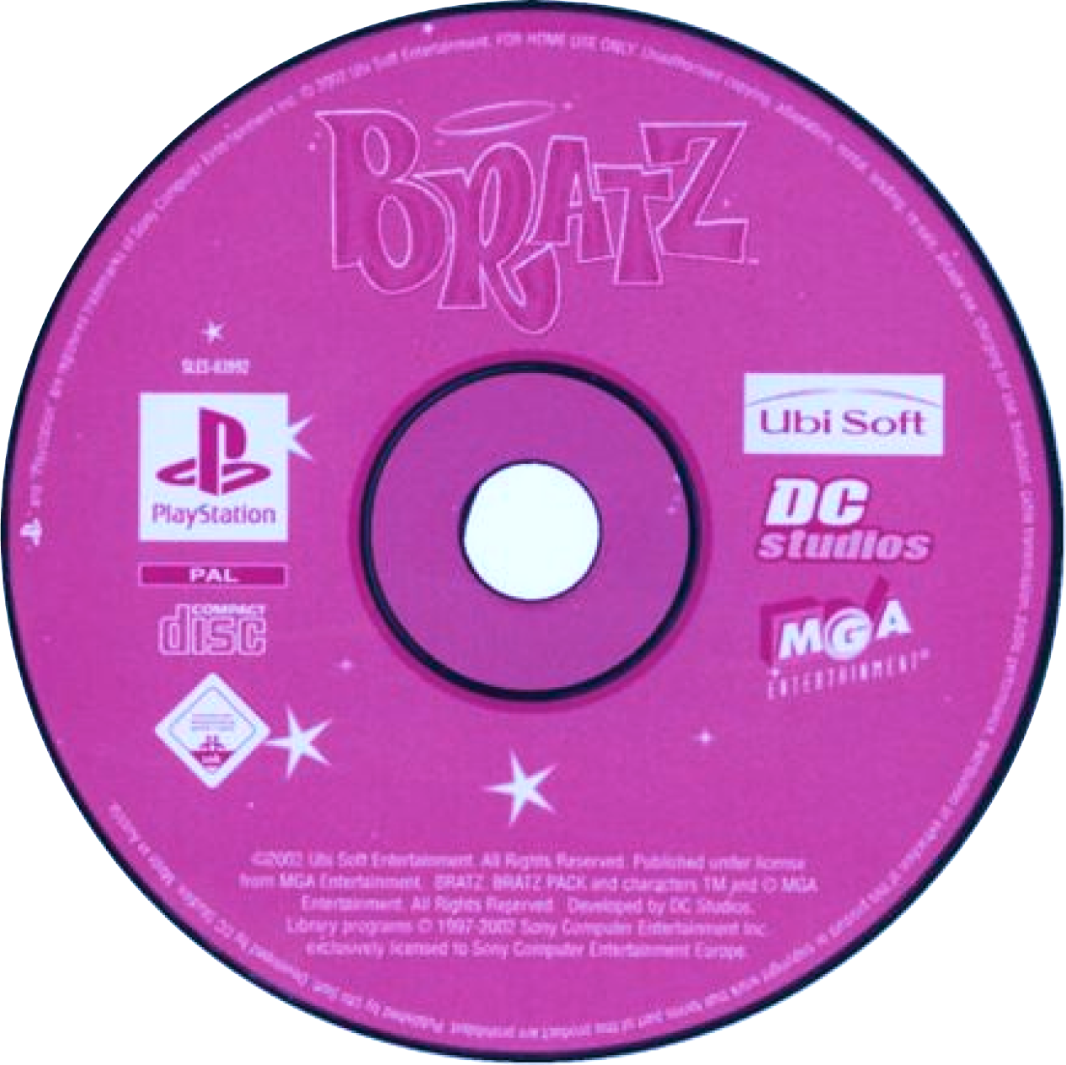






Slide 15
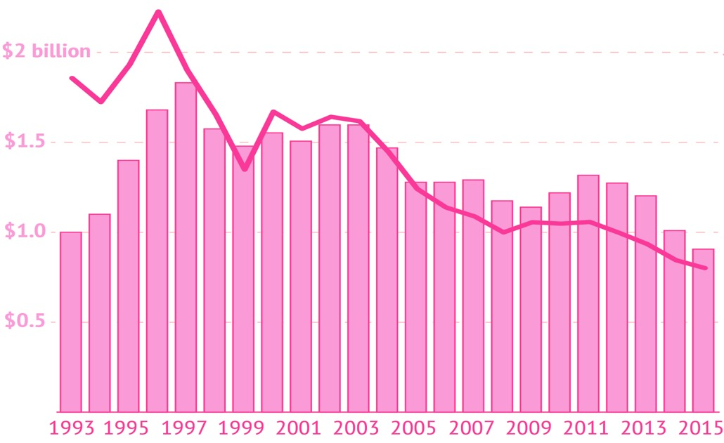
BARBIE SHOWS HER AGE!
Barbie brand sales at their lowest in at least 23 years. The doll brand also represents a much lower percentage of overall sales for Mattel.

Slide 16
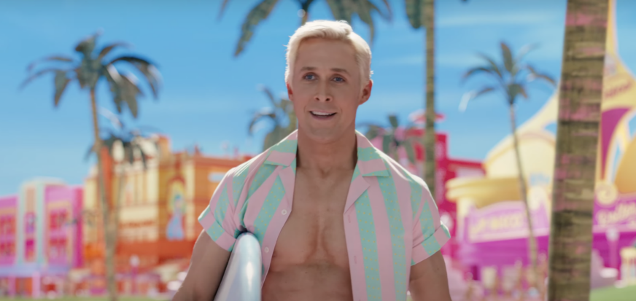

Its Ken-tastic!

Slide 17
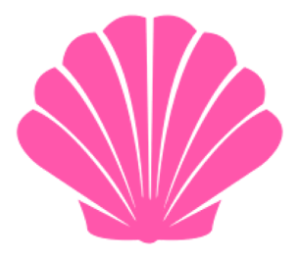
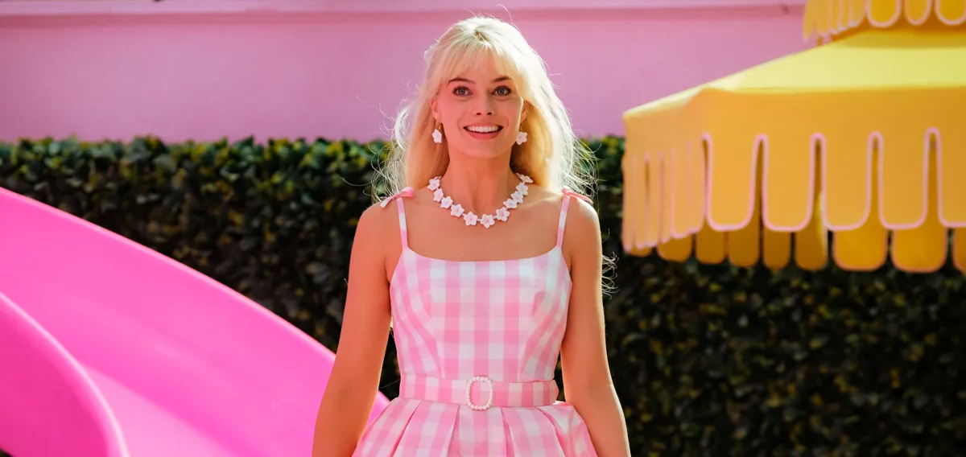
Doll-icious Diva

Slide 18
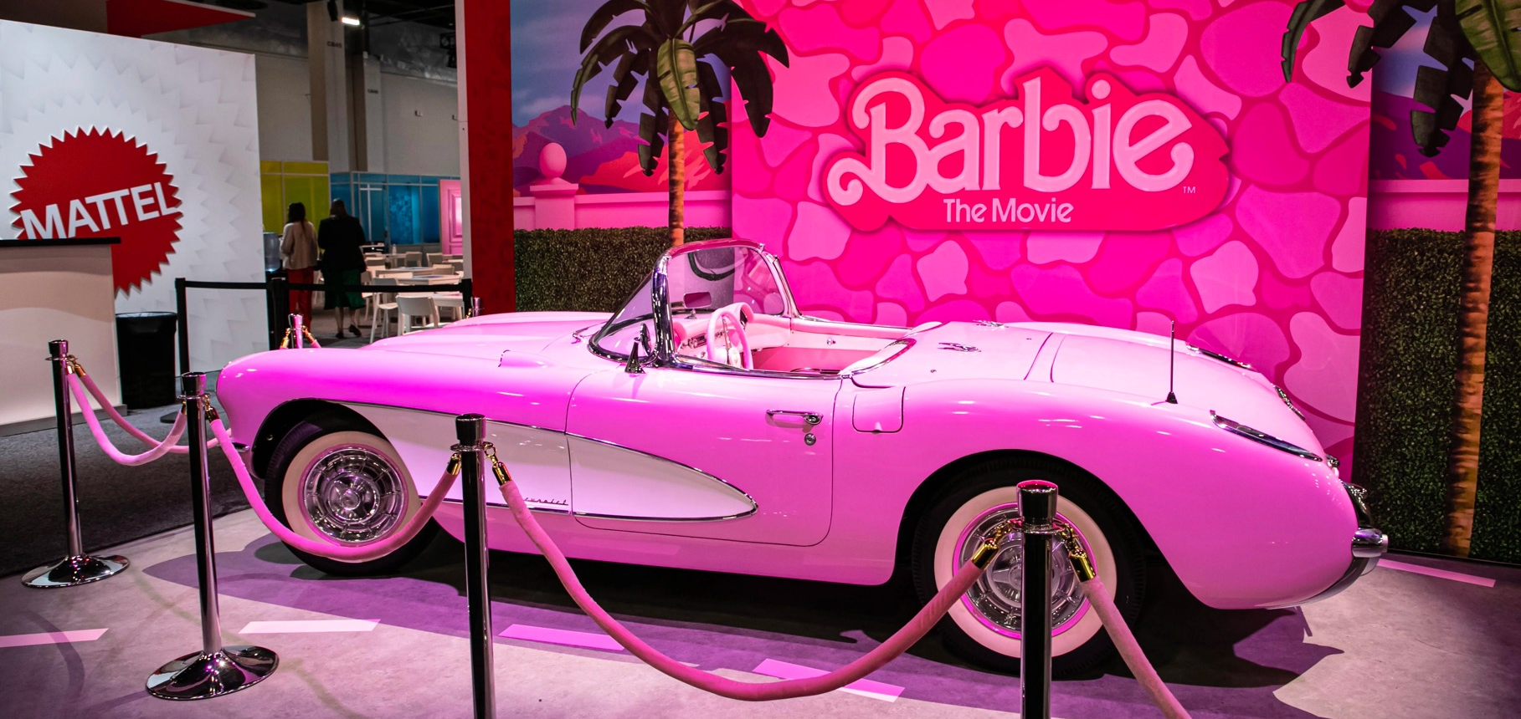
Pink Palace

Slide 19
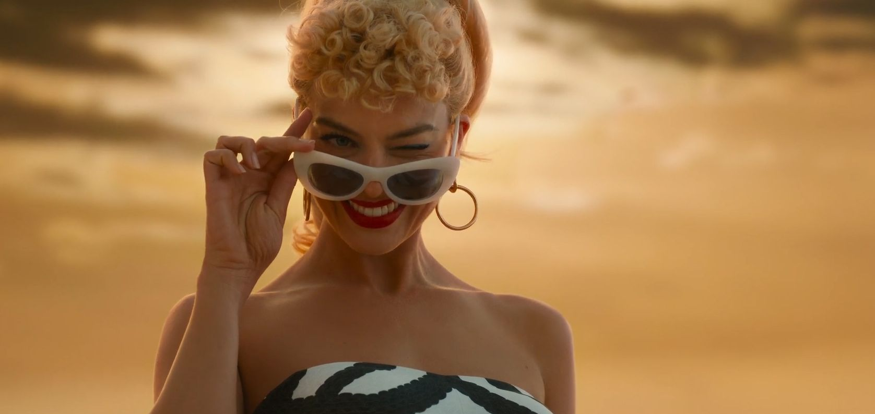
Power of Pink

Slide 20
Barbie
core
STARTER PACK

Slide 21
If you love Barbie, this PowerPoint is for you!

Slide 22
Barbie
Introduction
is
What
-core?
History of Barbiecore

